Slide 1
TEOA Lean Essentials Advanced Boot Camp
Guiding Principles
Notes:
This module should take around 15 minutes total

Slide 2
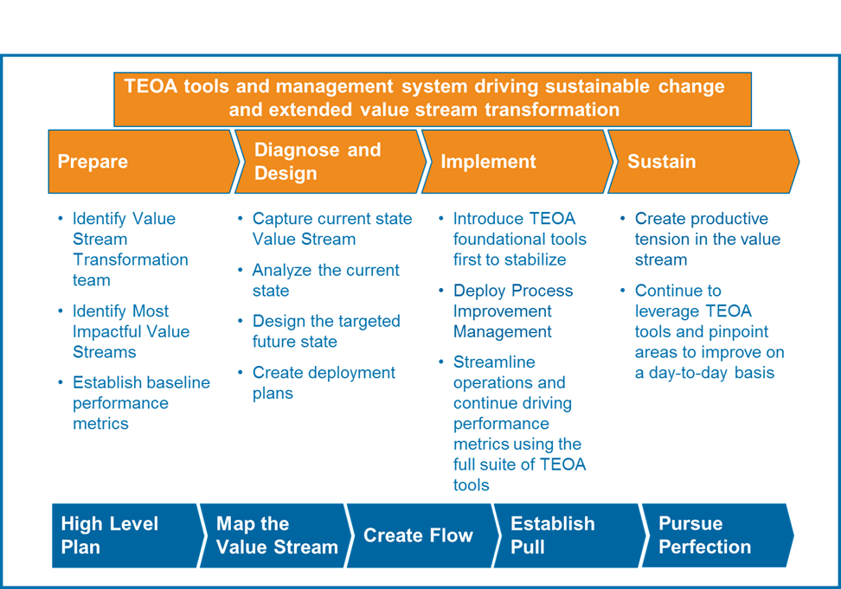
Value Stream Transformation
Notes:
Walk through the transformation – this is a very high level transformation approach – this week will focus in the Diagnose and Design phase where we are going to design the targeted future state and create an executable deployment plan. Stages 4 & 5 discussed in the overview take place during the implement and sustain phases.
We should poll the class, why are they here? Why did the plant manager send them – ultimately to transform a VS. Advise each team to review this value stream transformation approach with the site leadership upon returning to ensure that everyone understands what the objective is over the transformation.

Slide 3
Program Timeline
Advanced Training program - 5 Stage Process & Deliverables
Stage 1
Pre-work
Stage 2
Advanced Boot Camp Training
Stage 3
Confirmation System Design
Stage 4
Implementation
Stage 5
Sustain & Success Sharing
Identify Value Stream Candidates
Current State VSM & Data
Reading (Supply Chain Essentials, Making Materials Flow, Creating Level Pull, Creating Continuous Flow, Learning to See
Volcano Case Study & CVSM
Guiding Principles
Demand Analysis
Segmentation Methods
Lean Future State Design & Mapping
Continuous Flow
Level Pull Systems
Material and Information Conveyance routes
Lean scheduling methodologies
Deployment Plan creation
Value Stream Guiding Principles
Kickoff meeting with site and value stream leadership
Confirmation of Diagnose & Design Phase (see Transformation Roadmap)
Follow deployment plan
Review deployment plan on regular cadence
Refine Items Above Through Proof of Concept Work
PIM established
Evaluate Level of Production Tension
Adjust
Share aggressively
Celebrate Success
Prepare for 2nd iteration of transformation
Executive Report Out to Senior Leadership
Week t = -4
Week t = 0
Weeks t = +1 to 2
Weeks t= +2 to 12
Weeks t= +12 to 16
Notes:
This was covered in the introduction, so do not go through the stages again, but emphasize that one of the first things that each team will do upon returning to their site is establish guiding principles as a team.
Explain that the guiding principles will be a set of statements that will steer the entire direction of the transformation; these should be high level statements on the overall objectives of the transformation; they should include some reference to flow or pull; possibly some aspect of training / cultural transformation, linkages to providing an ECE, financial performance etc.
Guiding principles are critical because there will be pushback throughout the implementation, and some decision making options may conflict with guiding principles (e.g. earning hours and making things that the customer does not need instead of setting up a pull system and only running what has been consumed; allowing traditional MRP logic and forecasts to drive production; keeping large unsafe pallets on the production floor instead of making safety a top priority); the guiding principles allow the transformation team to take the emotion out of the decision making, and ask themselves “Does this support my guiding principles?”; every activity that occurs throughout the implementation should support the guiding prinicples established by the team

Slide 4
Keys to Success
Select a Team
Follow the Process
Establish Guiding Principles as a Team
Adhere to the Guiding Principles
And, Finally, Remember…
Brown Field Thinking will never create a World-Class GREEN Field result
Notes:
Think outside of the box when creating the principles – no 2 plants are exactly the same, so no 2 plants / value streams guiding principles should be exactly the same
Do not say “Cannot do that” or “That will never work” – think of what can be accomplished now, and then other longer term objectives – are we setting ourselves up to be the best operating team in the future? Do our guiding principles now support the strategic vision of the future?
If we are limited to the way we currently do things, we will never achieve the best, most elegant, star level 5, world class designs

Slide 5
Appendix
Detailed Examples

Slide 6
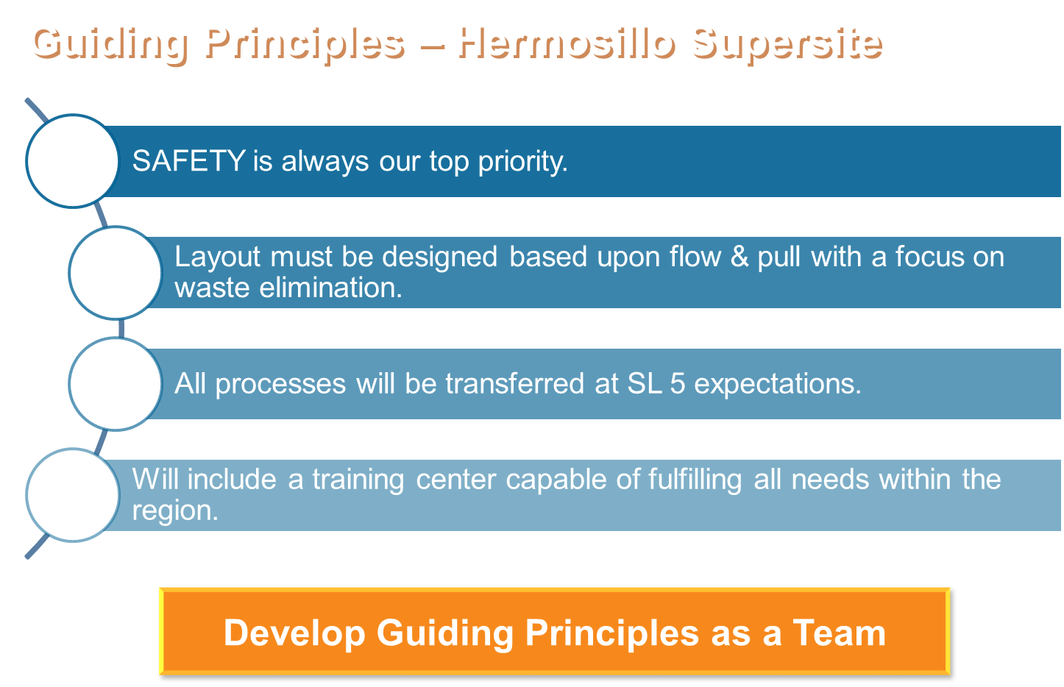
_{EXAMPLE ONLY}
Notes:
Just a few examples of the Guiding Principles Like
Safety is always a top priority and you will see that in the Material and People Flows, We have some real believers on safety as we saw in our safety performance yesterday but you always have to keep reinforcing that it is number one
Layouts must be designed upon Flow and Pull with a focus on waste elimination. This should look familiar to Shizouka because we used some of your Guiding Principles in the development of ours and finally
ALL processes transferred at Star Level 5 expectations. If I had shown that on a slide 4 years ago it wouldn’t even have made sense but 88% now at SL 3. And the awards ceremony was great last night wasn’t it for all those certified sites. And many are approaching Star 4. So we are at a Maturity level in TEOA that calls for this type of thinking.
This is a choice and a plan to be great and if you are planning to be great and to set up TEOA Role Models why not make those learning labs by having excellent Training facilities to support the region.
The key is not just to have guiding principles but to develop these guiding principles as a TEAM. This is so important to get not only buy-in and involvement but also for continuity when team members change.

Slide 7
_{Guiding Principles}
_{EXAMPLE ONLY}
Truly eliminate push ➔ Create LEVEL PULL end-to-end.
Share aggressively (Fairview, Triad Dr, Hermosillo)
The visuals support a well-structured Tiered Accountability Process with a robust audit system cadence.
_{Follow The Process}
Notes:
Could not flow right away at this plant (probably ever because of space / capital constraints) so their first objective was to create level pull end to end
Sharing aggressively was and continued to be a pillar – other TE plants in the surrounding area, outside of their BU, that they wanted to share with and learn from
Robust visual factory with a mature PIM process

Slide 8
Material Replenishment & Flow Guiding Principles – Greensboro Campus
_{EXAMPLE ONLY}
SAFETY first in EVERYTHING we do!
Eliminate Forklift Traffic from the manufacturing areas
Design layout to improve flow and eliminate waste.
Keep only the material needed at each work center (2 hours)
Teach people the why first, then the how
Teach people MR&F Principles through Boot Camps
All new processes should be SL5 capable at release
Engage launch teams on front end of new projects
_{Follow The Process}
Develop Guiding Principles as a Team

Slide 9
Greenfield Site Guiding Principles (10/30/2012)
SAFETY is always our top priority
The site must be flexible for continuous improvement & future growth (definition of flexible with Ops Council input)
Clearly aligned on integrated Value Streams (Extended)
Extended requires all functions represented on site
Layout must be designed based upon flow & pull with a focus on waste elimination
Use a centralized supermarket, designed standard material conveyance routes and Point Of Use (POU) all covered with Standard Work
Plan For Every Part (PFEP) defined and maintained
Conveyance intervals must be no more than 1 hour
POU storage equals two times material conveyance interval
POU means at the operator finger tips ready to use (VA operators do VA work)
Every VS is connected to the standardized material conveyance route
_{EXAMPLE ONLY}
Notes:
The next 3 slides are much more detailed / specific guiding principles – I would almost describe them as supporting guiding principles; just put more details in this plant’s higher level guiding principles

Slide 10
Greenfield Site Guiding Principles (10/30/2012)
For MTO style parts, material is managed through FIFO lanes from the upstream pacemaker
All raw and component inventory is managed by the 3PL and connected to the standardized conveyance route by way of milk runs to POUs
Finished Goods Distribution Center is managed by 3PL
Define shared resources opportunities and utilize appropriately
Quality systems are defined by the customer requirements with each BU factory and unified under the most robust market / industry requirement in cases where there are shared processes across BUs
All processes will be transferred at SL 5 expectations.
IE. not a hodge-podge of inconsistent processes
No Brownfield in a Greenfield site
_{EXAMPLE ONLY}

Slide 11
Greenfield Site Guiding Principles (10/30/2012)
The visuals support a well structured Tier Accountability Process
Upfront design for these needs (Examples: GO Meetings, Accountability boards)
No barriers for verbal and visual communications
Support offices are co–located with the Value Stream
LEED (Leadership in Energy & Environmental Design), showcasing TE Connectivity products for sustainability
Everything must be reusable or recyclable (Example: No cardboard on the shop floor)
Local repolymerization source
Will include a training center capable of fulfilling all needs within the sub-region
At the Cell level, design the physical process layout so one person can make one piece as effectively as possible.
_{EXAMPLE ONLY}

